Slide 1
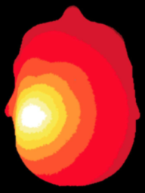
NeuroDOT
Tutorial:
Data Quality, Pre-processing, and Reconstruction

Slide 2
NeuroDOT Set-Up - Checklist
Before starting any tutorial, please make sure you’ve done the following
Download the appropriate versions of matlab, neuroDOT, and NIRFAST
Matlab: 2020b
NeuroDOT toolbox from NITRC
https://www.nitrc.org/projects/neurodot/
NIRFASTer-master
https://github.com/nirfaster/NIRFASTer
Set your path so that all required folders and subfolders are included
Folders w/subfolders to include
NeuroDOT toolbox
NIRFASTer-master
Your personal directory
Folders to include
Output directory

Slide 3


NeuroDOT Set-Up – Output Directory
Example output directory
Once you’ve set your path, the next thing you should do is set your output directory.
The output directory must be located within your path
If it isn’t already in your path, you must add it to your path
You can set your own path to an output directory in the line shown above
An output directory specifies the location where files will be saved
MATLAB, by default, will save files to the current directory
The following line of code will change your current directory to the output directory that you just specified →
Now you can save outputs directly to your output directory

Slide 4
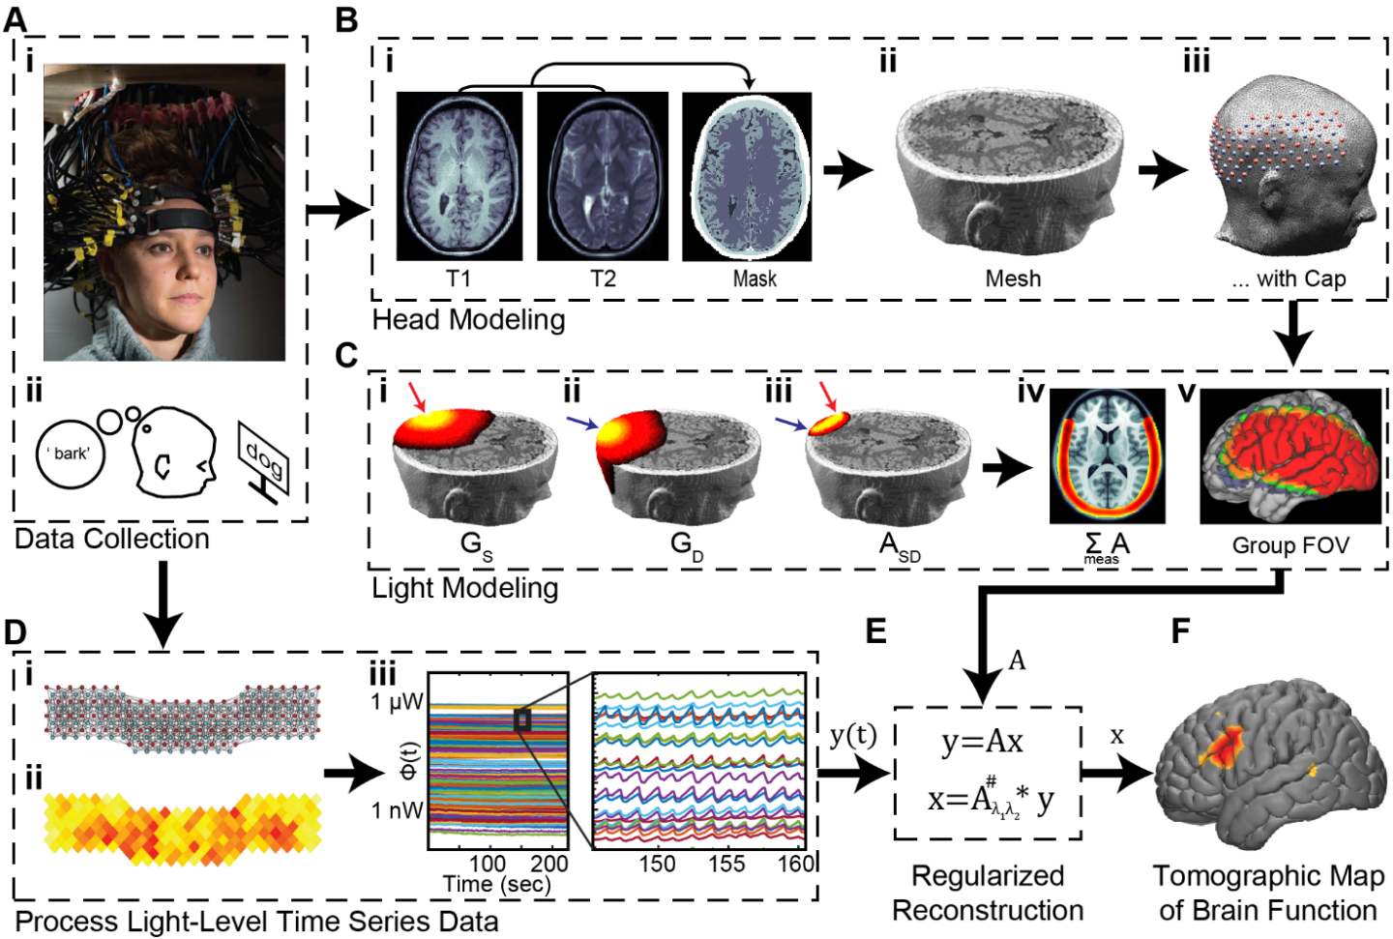
Diffuse Optical Tomography
In diffuse optical tomography (DOT), arrays of optical sources and detectors are used to perform functional neuroimaging experiments on task-based or resting state modes of human brain function.
Analyses are broken into several pipelines:
B: modeling of the tissue shape, optical property distribution, and source/detector locations
C: modeling of the light emission, diffusion, and detection through the head
D: preprocessing of the raw source-detector measurements
E: reconstruction and spectroscopy of the preprocessed data and light model into a functional neuroimaging volume
F: post-processing analysis of these results.

Slide 5
Pre-processing and Image Reconstruction
This tutorial will follow the NeuroDOT_Full_Processing_Script.m Matlab file which can be found in the Documentation/Scripts folder.
This version of the Full Data Processing tutorial utilizes the CCW1 data sample which can be found in the Data/ folder of the NeuroDOT toolbox
The tutorial will:
Generate raw data quality assessment figures
Process and visualize source-detector measurements
Perform image reconstruction using a light model sensitivity matrix A
Visualize the reconstructed data
We will use data from a rotating-wedge retinotopy experiment

Slide 6
Pre-processing and Image Reconstruction
To fully processes the Sample Datasets contained within the toolbox, you will need to generate the Sensitivity matrices for the 24x28 and 96x92 (source x detector) arrays.
If these Sensitivity matrices have not yet been generated, you can make them using the files and scripts included in the toolbox.
To do so, please see the NeuroDOT_Tutorial_Generating_a_Light_Model_with_AlignMe.pptx and its associated script for the 24x28 array and the …Pad_Adult_96x92_Example.pptx and its associated script for the 96x92 array.
After generating, be sure to add the name of the relevant Sensitivity matrix file to the %% Load Measurement data section of the NeuroDOT_Full_Processing_Script_Tutorial.m script.

Slide 7
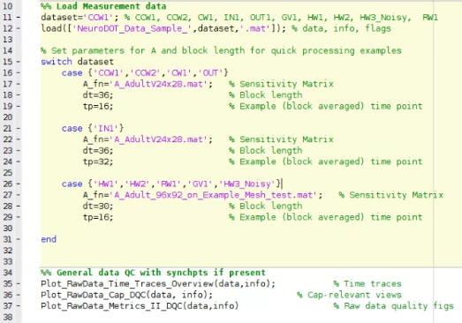
Running the script – Author’s Note
How the author runs the script
Highlight and execute each chunk of code
Ex: highlight lines 11 and 12 → right click → hit “Evaluate Selection”
Alternate way of running the script
For each section (beige) hit ctrl+enter
This isn’t how the author does it, but it will still work
Note: DO NOT HIT THE GREEN “RUN” BUTTON to run this script
Example
section

Slide 8
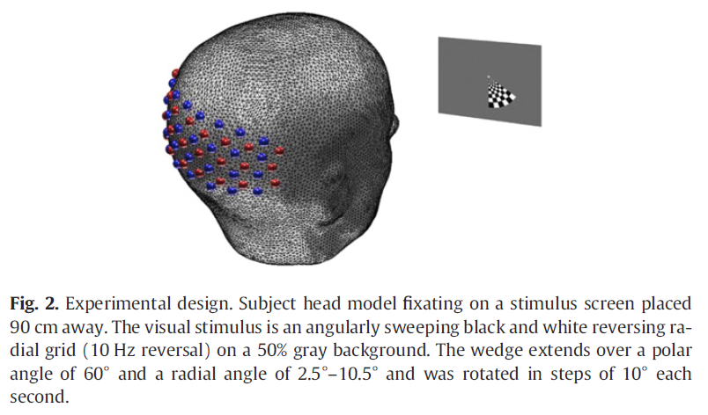
NeuroDOT_Data_Sample_CCW1.mat
The CCW1 data set is one of those acquired for the Eggebrecht et al., Neuroimage, 2012 paper.
Note: NeuroDOT is compatible with various raw data file formats including *.mat (shown in this tutorial), *.snirf, and *.nirs.
The PowerPoint “Tutorial_for_Loading_Raw_Data” and corresponding script “Script_for_Loading_Raw_Data” provide details on how to load raw data in these formats.
Briefly, the participant gazed upon a fixation cross while a reversing checkerboard progressed in the counter-clockwise (CCW) direction.
In the figures below, synchronization points labelled with a red line denote resting epochs; those with a green line denote the start of the CCW block wherein the flickering wedge is located at 6:00.
Please see the paper for more information.
Matlab code segments that can be copied and pasted into matlab to be run are in Courier BOLD font.
dataset='CCW1';
load(['NeuroDOT_Data_Sample_',dataset,'.mat']); % data, info, flags
% Set parameters for A and block length for quick processing examples
switch dataset
case {'CCW1','CCW2','CW1','OUT'}
A_fn='A_AdultV24x28.mat'; % Sensitivity Matrix
dt=36; % Block length
tp=16; % Example (block averaged) time point
case {'IN1'}
A_fn='A_AdultV24x28.mat'; % Sensitivity Matrix
dt=36; % Block length
tp=32; % Example (block averaged) time point
case {'HW1','HW2','RW1','GV1','HW3_Noisy'}
A_fn='A_Adult_96x92_on_Example_Mesh_test.mat'; % Sensitivity Matrix
dt=30; % Block length
tp=16; % Example (block averaged) time point
end

Slide 9
Flow Chart for Pre-processing and Image Reconstruction
DOT Acquisition
Log-mean
Detect noisy channels
Band-pass filter
Superficial signal regression
Low-pass filter
Resample
Light
Model
Reconstruction
Spectroscopy
Spatial normalization

Slide 10
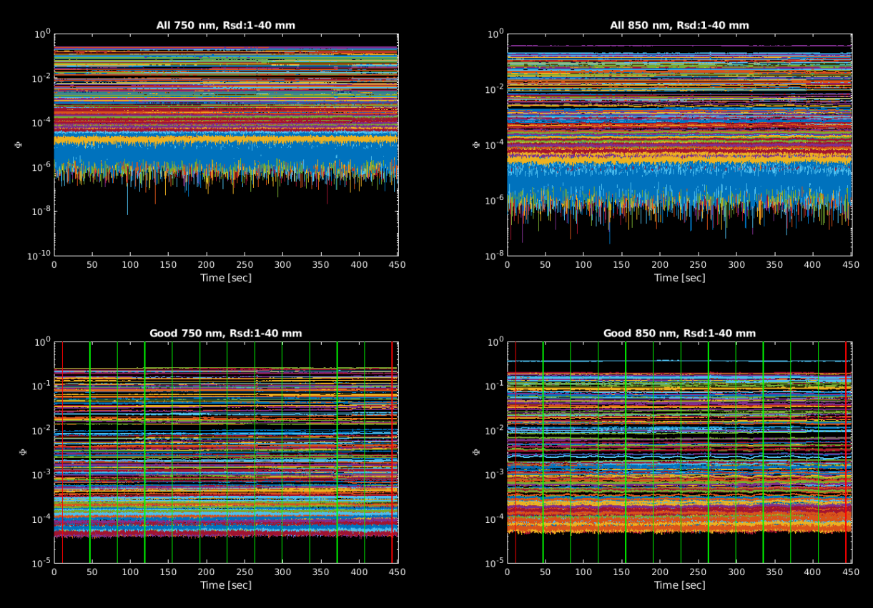
Raw Data Quality Assessment: Time Traces
DOT Acquisition
Plot_RawData_Time_Traces_Overview(data,info);
The left panels show data at 750 nm and the right panels show data at 850 nm.
The top panels show all measurements and the bottom panels measurements with standard deviation below a set threshold
The y-axis on all is log scale to highlight the range of light levels for the set of source-detector distances.
Vertical lines on the bottom row of plots signify time points where something happened in the stimulus paradigm.

Slide 11
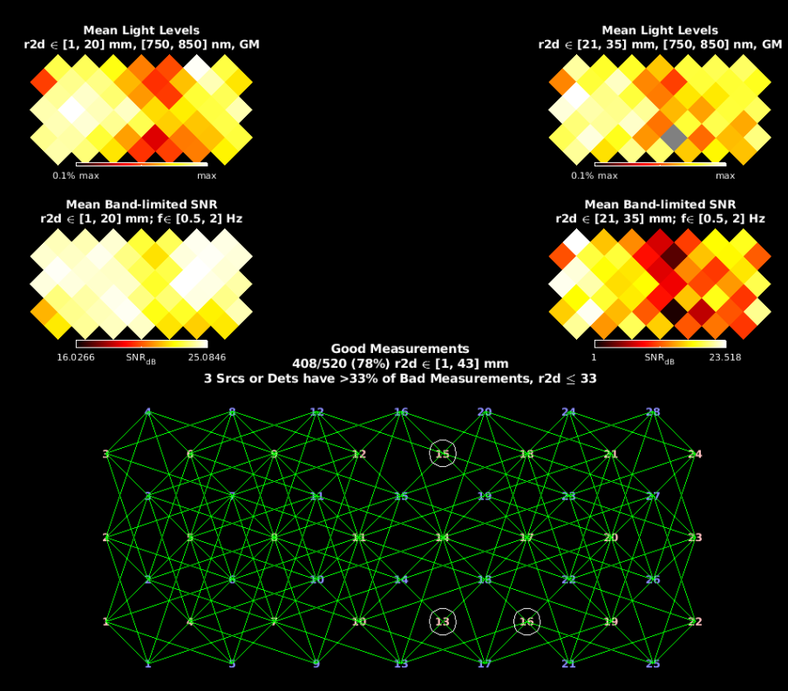
Raw Data Quality Assessment: Cap-relevant views
DOT Acquisition
Plot_RawData_Cap_DQC(data,info);
Top row shows average light levels for short-distance (left) and medium-distance (right) measurements. Good coupling across the entire cap results in mostly white and yellow in these figures.
Middle row show signal-to-noise ratio (SNR) for cardiac pulse band of frequencies.
Bottom edge plot shows measurements that satisfy the criteria. Optodes that have multiple ‘bad’ measurements are identified with large circles.

Slide 12
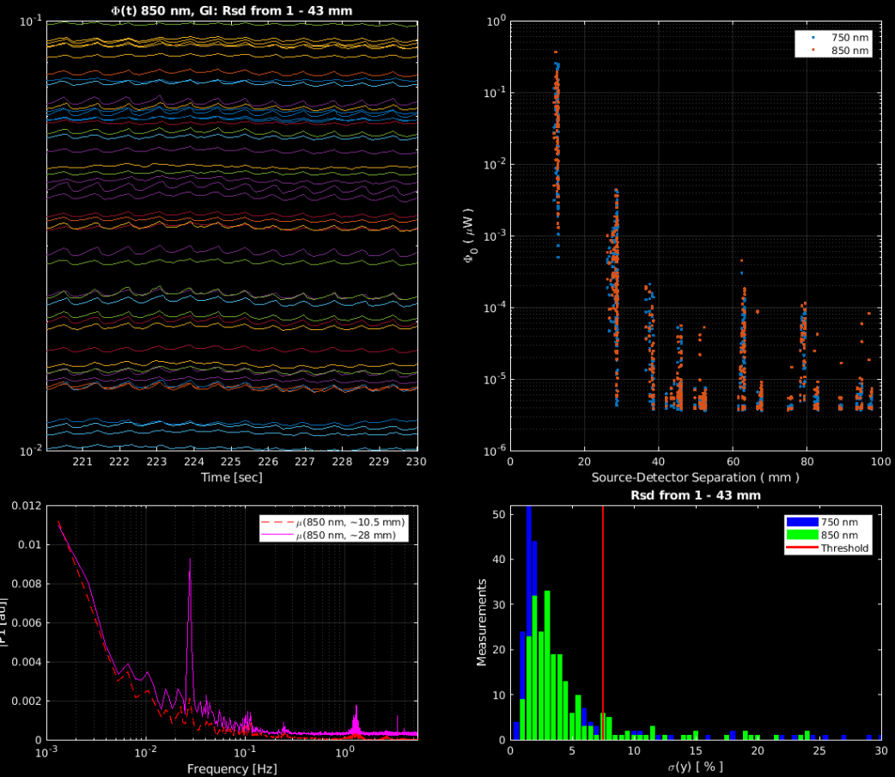
Raw Data Quality Assessment: The signal and the noise
DOT Acquisition
Plot_RawData_Metrics_I_DQC(data,info)
(Upper left) A zoomed-in view of several signals shows the presence of cardiac pulse at approximately 1 Hz.
(Lower left) Spectral measures averaged over several time traces show strong peaks at ~1Hz (cardiac pulse) and approximately 1/26 Hz (the stimulus frequency).
(Upper right) Light level (log) vs. source-detector distance shows expected falloff, with cross-talk at distances > 45 mm.
(Lower right) Histogram of signal % standard deviation shows several measurements below ‘good measurement’ threshold of 7.5%.

Slide 13
Pre-processing
DOT Acquisition
Pre-processing generally follows the pipeline on the right, as shown below:
lmdata = logmean(data); % Logmean Light Levels
info = FindGoodMeas(lmdata, info, 0.075); % Detect Noisy Channels
lmdata = detrend_tts(lmdata); % Detrend Data
lmdata = highpass(lmdata, .02, info.system.framerate); % High Pass Filter
lmdata = lowpass(lmdata, 1, info.system.framerate); % Low Pass Filter 1
hem = gethem(lmdata, info); % Superficial Signal Regression
[lmdata, ~] = regcorr(lmdata, info, hem);
lmdata = lowpass(lmdata, 0.5, info.system.framerate); % Low Pass Filter 2
[lmdata, info] = resample_tts(lmdata, info, 1, 1e-5); % 1 Hz Resampling
info.GVTD = CalcGVTD(lmdata(info.MEAS.GI & info.pairs.r2d<20,:)); % Calculate GVTD
Pre-processing can be broken down into two chunks, pre-filtering, and filtering. Both of these stages will be visualized in the following slides
Subsequent plots and images show differential measurements, computed as the logarithm of the ratio of each signal and its temporal average
For a more in-depth exploration of pre-processing parameter settings, please see the Tutorial on Pre-processing.
Log-mean
Detect noisy channels
Band-pass filter
Superficial signal regression
Low-pass filter
Resample

Slide 14
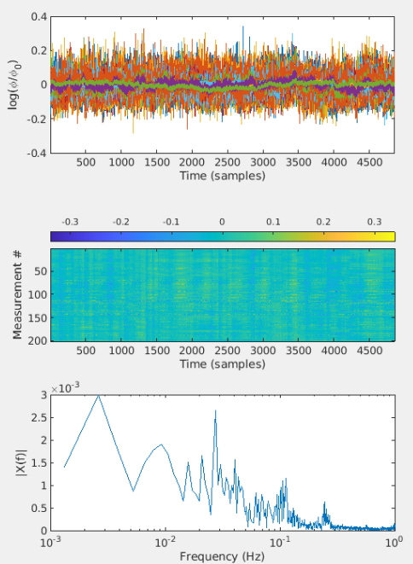
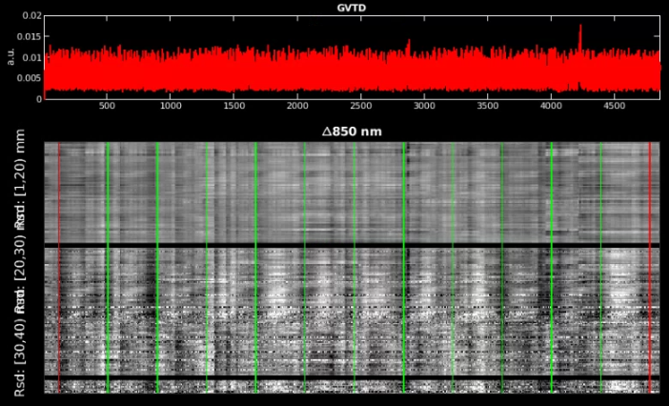
Pre-processing: pre-filtering
Before filtering the data, take the log-mean and detect noisy channels, then visualize
lmdata_b4_filt = logmean(data); % Logmean Light Levels
info_b4_filt = FindGoodMeas(lmdata_b4_filt , info, 0.075); % Detect Noisy Channels
lmdata_b4_filt = detrend_tts(lmdata_b4_filt ); % Detrend Data
info_b4_filt.GVTD = CalcGVTD(lmdata_b4_filt(info_b4_filt.MEAS.GI & info_b4_filt.pairs.r2d<20,:)); % GVTD
% Measurements to include
keep = info_b4_filt.pairs.WL==2 & info_b4_filt.pairs.r2d < 40 & info_b4_filt.MEAS.GI;
% Visualize
figure('Position',[100 100 550 780])
subplot(3,1,1); plot(lmdata_b4_filt(keep,:)');
set(gca,'XLimSpec','tight'), xlabel('Time (samples)'),
ylabel('log(\phi/\phi_0)')
m=max(max(abs(lmdata_b4_filt(keep,:))));
subplot(3,1,2); imagesc(lmdata_b4_filt(keep,:),[-1,1].*m);
colorbar('Location','northoutside');
xlabel('Time (samples)');ylabel('Measurement #')
[ftmag,ftdomain] = fft_tts(squeeze(mean(lmdata_b4_filt(keep,:),1)),info_b4_filt.system.framerate); % Generate average spectrum
subplot(3,1,3); semilogx(ftdomain,ftmag);
xlabel('Frequency (Hz)');ylabel('|X(f)|');xlim([1e-3 1])
nlrGrayPlots_180818(lmdata_b4_filt,info_b4_filt); % Gray Plot with synch points
Next, lets fully pre-process the data to view the effects of filtering

Slide 15
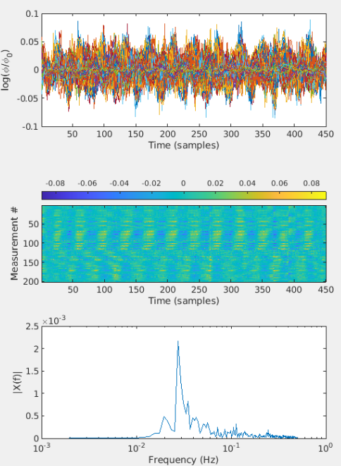
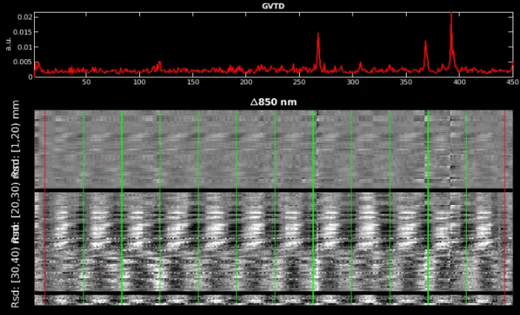
Pre-processing: post-filtering
Full pre-processing pipeline
lmdata = logmean(data); % Logmean Light Levels
info = FindGoodMeas(lmdata, info, 0.075); % Detect Noisy Channels
lmdata = detrend_tts(lmdata); % Detrend Data
lmdata = highpass(lmdata, .02, info.system.framerate); % High Pass Filter (0.02 Hz)
lmdata = lowpass(lmdata, 1, info.system.framerate); % Low Pass Filter 1 (1.0 Hz)
hem = gethem(lmdata, info); % Superficial Signal Regression
[lmdata, ~] = regcorr(lmdata, info, hem);
lmdata = lowpass(lmdata, 0.5, info.system.framerate); % Low Pass Filter 2 (0.5 Hz)
[lmdata, info] = resample_tts(lmdata, info, 1, 1e-5); % 1 Hz Resampling (1 Hz)
info.GVTD = CalcGVTD(lmdata(info.MEAS.GI & info.pairs.r2d<20,:)); % Calculate GVTD
Visualize
keep = info.pairs.WL==2 & info.pairs.r2d < 40 & info.MEAS.GI; % measurements to include
figure('Position',[100 100 550 780])
subplot(3,1,1); plot(lmdata(keep,:)');
set(gca,'XLimSpec','tight'), xlabel('Time (samples)'),
ylabel('log(\phi/\phi_0)')
m=max(max(abs(lmdata(keep,:))));
subplot(3,1,2); imagesc(lmdata(keep,:),[-1,1].*m);
colorbar('Location','northoutside');
xlabel('Time (samples)');ylabel('Measurement #')
[ftmag,ftdomain] = fft_tts(squeeze(mean(lmdata(keep,:),1)),info.system.framerate);
subplot(3,1,3); semilogx(ftdomain,ftmag);
xlabel('Frequency (Hz)');ylabel('|X(f)|');xlim([1e-3 1])
nlrGrayPlots_180818(lmdata,info); % Gray Plot with synch points

Slide 16

View effects of Pre-processing side-by-side
(Top) raw data plot
Notice that after filtering, the length of time shrinks. This is because we filtered out both low, and high frequency noise
(Middle) image plot of scaled data
Notice that both the time (x axis) and range of the data (colorscale) are lower after filtering
This is because noise is removed during filtering
(Bottom) Fourier Transformed Data
Generates an average of the top plot, but on a log-scaled x axis
Notice that after filtering the data, signal below ${\sim 10}^{−2}$ and above ${\sim 10}^{−1}$ is cropped, allowing for a better focus on brain activity
Before
After

Slide 17
View effects of Pre-processing side-by-side Gray plots
Peaks in the top plot and vertical lines in the bottom plot denote times where there is high noise
Before filtering plot has a lot of these
After filtering, high and low frequency noise has been removed, only a few, if any, peaks/vertical lines will remain
The noise that remains is due to participant motion
nlrGrayPlots_180818(lmdata,info); % Gray Plot with synch points
Before
After

Slide 18
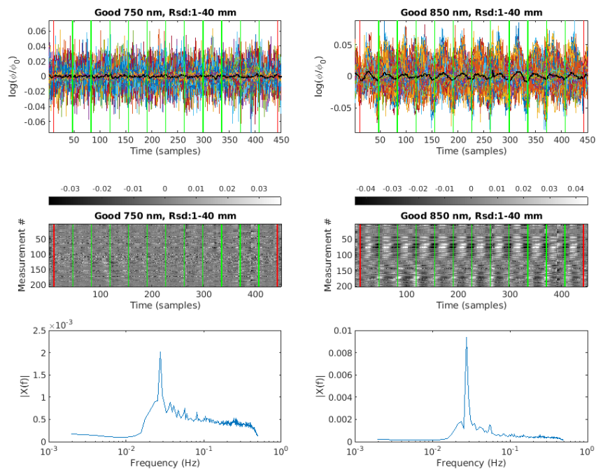
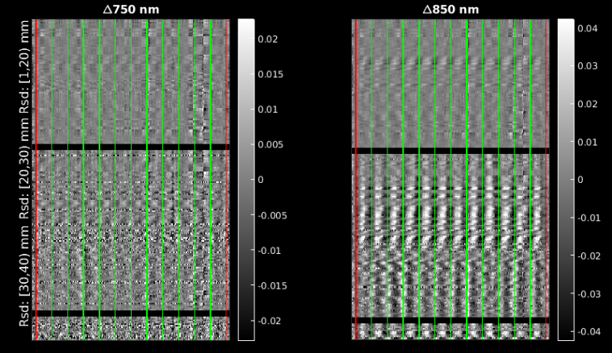
View effects of Pre-processing Wavelength comparison
Plot_TimeTrace_With_PowerSpectrum(lmdata,info); (right)
GrayPlots_Rsd_by_Wavelength(lmdata,info); (below)
Same plots as on previous slides, but with both wavelengths side by side

Slide 19
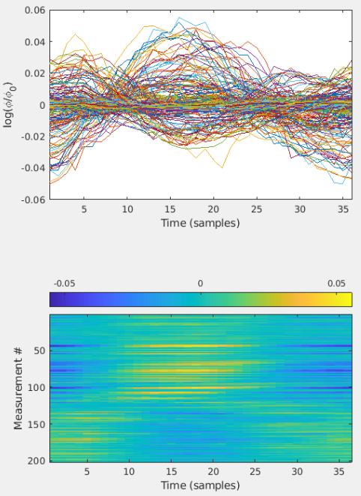
View effects of Pre-processing Block averaging
%% Block Averaging the measurement data and view
badata = BlockAverage(lmdata, info.paradigm.synchpts(info.paradigm.Pulse_2), dt);
badata=bsxfun(@minus,badata,mean(badata,2));
figure('Position',[100 100 550 780])
subplot(2,1,1);
plot(badata(keep,:)');
set(gca,'XLimSpec','tight'), xlabel('Time (samples)'), …
ylabel('log(\phi/\phi_0)')
m=max(max(abs(badata(keep,:))));
subplot(2,1,2);
imagesc(badata(keep,:),[-1,1].*m);
colorbar('Location','northoutside');
xlabel('Time (samples)');
ylabel('Measurement #')

Slide 20
Reconstruction & Spectroscopy
DOT Acquisition
Absorption image volumes are reconstructed from the measurements based on a regularized inversion of the A matrix (for details, see, e.g., Eggebrecht et al., Neuroimage, 2012)
%% Reconstruction Pipeline
if ~exist('A', 'var') % In case running by hand or re-running script
A=load([A_fn],'info','A');
if length(size(A.A))>2 % A data structure [wl X meas X vox]-->[meas X vox]
[Nwl,Nmeas,Nvox]=size(A.A);
A.A=reshape(permute(A.A,[2,1,3]),Nwl*Nmeas,Nvox);
end
end
Nvox=size(A.A,2);
Nt=size(lmdata,2);
cortex_mu_a=zeros(Nvox,Nt,2);
for j = 1:2
keep = (info.pairs.WL == j) & (info.pairs.r2d <= 40) & info.MEAS.GI;
disp('> Inverting A')
iA = Tikhonov_invert_Amat(A.A(keep, :), 0.01, 0.1); % Invert A-Matrix
disp('> Smoothing iA')
iA = smooth_Amat(iA, A.info.tissue.dim, 3); % Smooth Inverted A-Matrix
cortex_mu_a(:, :, j) = reconstruct_img(lmdata(keep, :), iA);% Reconstruct Image Volume
end
Image volumes store estimated absorption values as voxels by time by wavelength.
Hemoglobin images are computed from the wavelength-dependent absorption images
%% Spectroscopy
if ~exist('E', 'var'),load('E.mat'),end
cortex_Hb = spectroscopy_img(cortex_mu_a, E);
cortex_HbO = cortex_Hb(:, :, 1);
cortex_HbR = cortex_Hb(:, :, 2);
cortex_HbT = cortex_HbO + cortex_HbR;
Log-mean
Detect noisy channels
Band-pass filter
Superficial signal regression
Low-pass filter
Resample
Light
Model
Reconstruction
Spectroscopy

Slide 21
Spatial normalization
DOT Acquisition
The cortex_HbO data is in an array that is voxels by time where the voxels are within a subspace described by info.tissue.dim which itself is a subspace of the original anatomical volume used to generate the light model.
To properly contextualize the reconstructed data, it is helpful to view on an appropriate anatomical background.
The following lines will load in the anatomical data used for the light model and spatially register it to the reconstructed optical data.
[MNI,infoB]=LoadVolumetricData('Segmented_MNI152nl_on_MNI111_nifti',[],‘nii');
MNI_dim = affine3d_img(MNI,infoB,A.info.tissue.dim,eye(4),'nearest');
We are using nearest-neighbor interpolation here because we are transforming a mask, so we do not want the values to change.
The next lines will block average the HbO data and put it in the full voxel space to get it ready for visualization
% Block Average Data
badata_HbO = BlockAverage(cortex_HbO, info.paradigm.synchpts(info.paradigm.Pulse_2), dt);
badata_HbO=bsxfun(@minus,badata_HbO,badata_HbO(:,1));
badata_HbOvol = Good_Vox2vol(badata_HbO,A.info.tissue.dim);
tp_Eg=squeeze(badata_HbOvol(:,:,:,tp));
Log-mean
Detect noisy channels
Band-pass filter
Superficial signal regression
Low-pass filter
Resample
Light
Model
Reconstruction
Spectroscopy
Spatial normalization

Slide 22
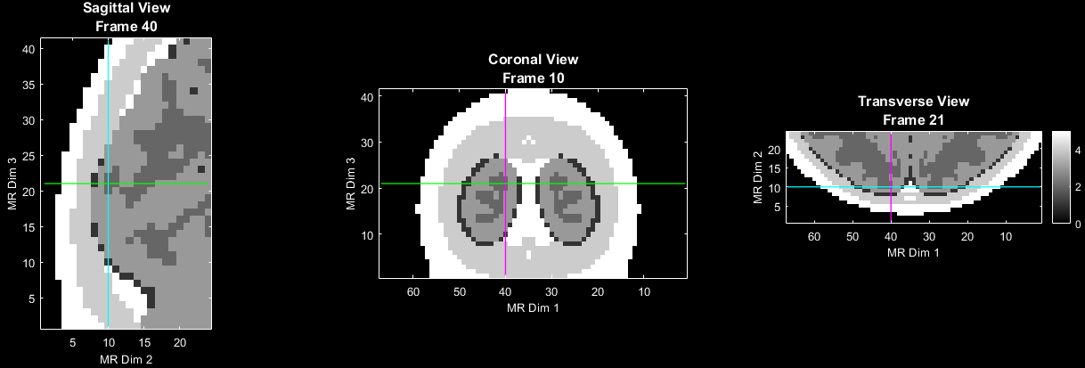
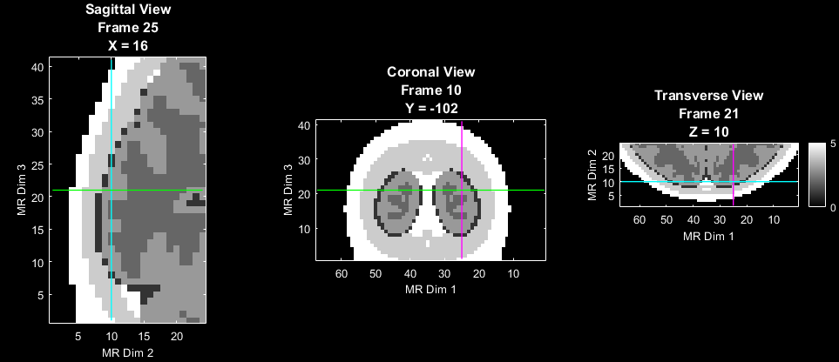
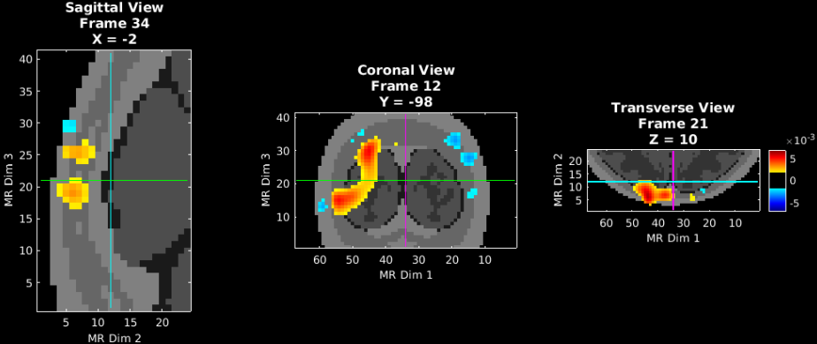
Visualization of Reconstructed Volumetric Images
To get a sense of how to visualize the volumetric info try first with the anatomical volume, use PlotSlices. Note that PlotSlices defaults to an interactive mode. Click in any view plane to browse the reconstructed volume.
When a slice is clicked, all of the slices update to the new coordinates based on the location clicked
Try to match your X, Y, Z positions to the images on the right ☺
Right click to reset to the original set of slices
Either middle mouse button (scroll wheel), or Q can be pressed to exit PlotSlices
Code will not continue until PlotSlices has been quit
(Top) Anatomy only
(Middle) Anatomy + volumetric data
(Bottom) Anatomy + volumetric data + functional data
PlotSlices(MNI_dim)
PlotSlices(MNI_dim,A.info.tissue.dim)
PlotSlices(MNI_dim,A.info.tissue.dim,[], tp_Eg)

Slide 23
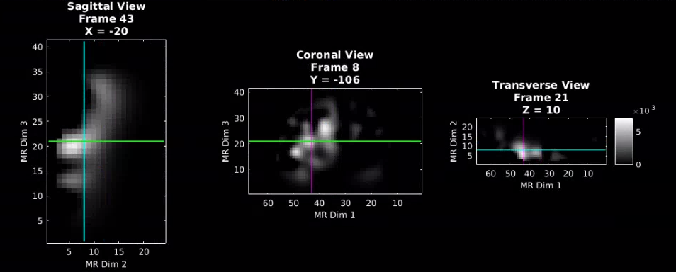
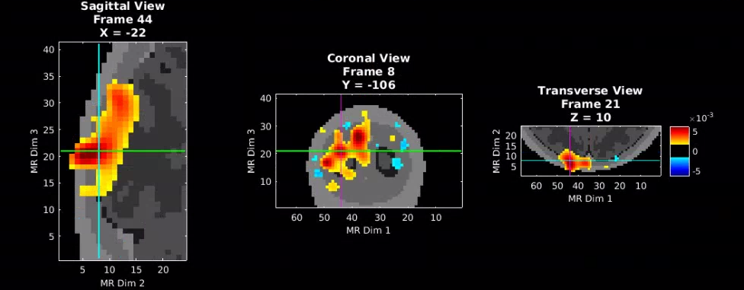
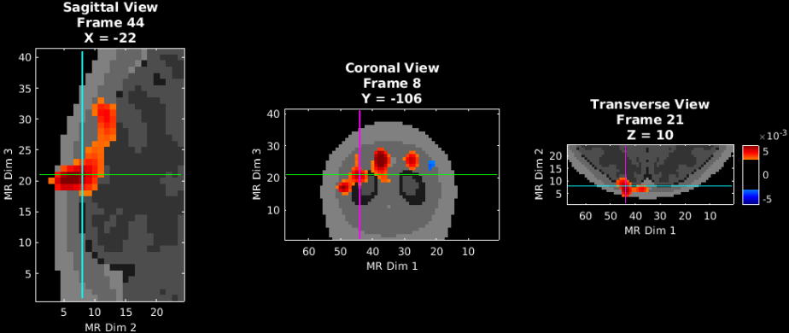
Visualization of Reconstructed Volumetric Images
Now, visualize the data. First by itself, then on top of the underlay and volumetric info. Then, set scaling and thresholding parameters to hone in on strong activations and visualize again.
Full code section
% Visualize the data
PlotSlices(tp_Eg,A.info.tissue.dim); %data by itself
PlotSlices(MNI_dim,A.info.tissue.dim,[],tp_Eg); %data with anatomical underlay
% Set parameters to visualize more specific aspects of data
Params.Scale=0.8*max(abs(tp_Eg(:))); %scale wrt/max of data
Params.Th.P=0.5*Params.Scale; %threshold to see strong activations
Params.Th.N=-Params.Th.P; %thresholds go both ways
Params.Cmap='jet';
PlotSlices(MNI_dim,A.info.tissue.dim,Params,tp_Eg);
Individual visualization lines
(Top) Functional data and volumetric info only
(Middle)
(Bottom)
PlotSlices(tp_Eg,A.info.tissue.dim);
PlotSlices(tp_Eg,A.info.tissue.dim, [], tp_Eg);
PlotSlices(tp_Eg,A.info.tissue.dim, Params, tp_Eg);

Slide 24
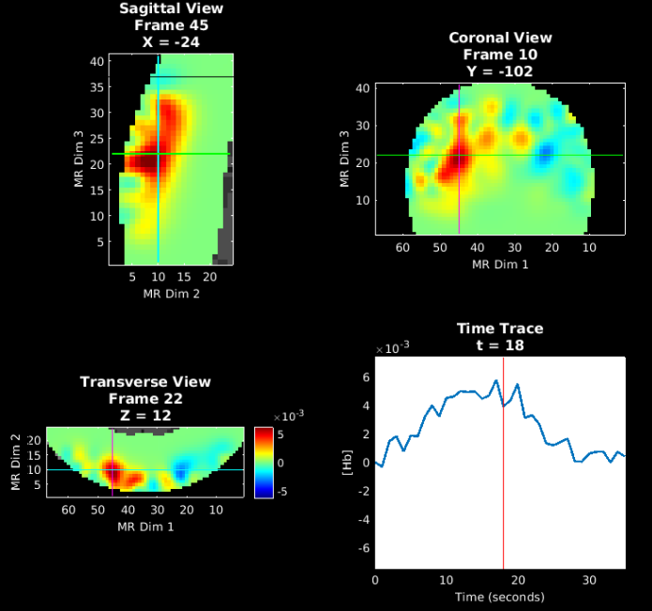
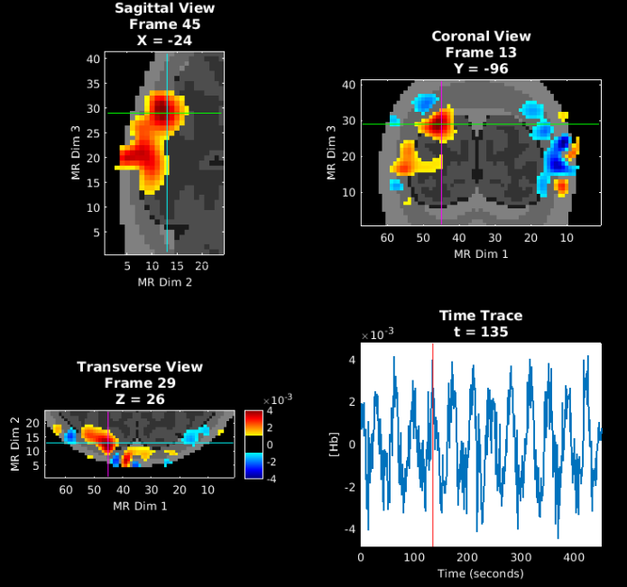
Visualization with Voxel Time Trace
Adding the time trace at the selected location further aids interpretation
% Explore the data a bit more interactively
Params.Scale=0.8*max(abs(badata_HbOvol(:)));
Params.Th.P=0;
Params.Th.N=-Params.Th.P;
PlotSlicesTimeTrace(MNI_dim,A.info.tissue.dim,Params,badata_HbOvol,info)
In this data set, regions within the visual cortex show varying time to peak response, corresponding to the varied position of the rotating checkerboard wedge.
These data are block-averaged, which reduces variance in the reconstructed signals. Visualizing the un-averaged data (next) can help in interpretation.
% Explore the not-block-averaged data a bit more interactively
HbOvol = Good_Vox2vol(cortex_HbO,A.info.tissue.dim);
Params.Scale=2e-3;
Params.Th.P=1e-3;
Params.Th.N=-Params.Th.P;
PlotSlicesTimeTrace(MNI_dim,A.info.tissue.dim,Params,HbOvol,info)

Slide 25
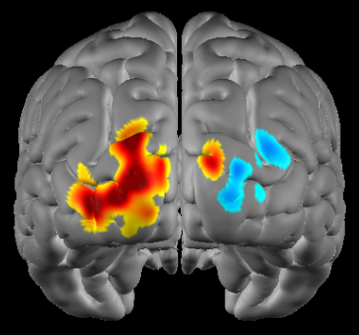
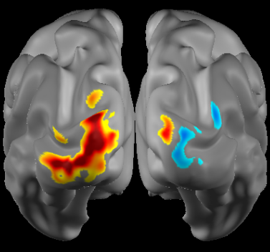
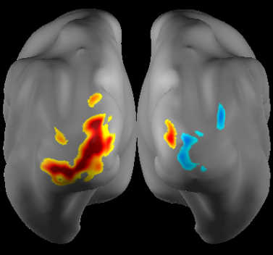
Visualization of reconstructed data on a surface model of the cortex
%% Select Surface visualizations
if ~exist('MNIl', 'var'),load(['MNI164k_big.mat']);end
HbO_atlas = affine3d_img(badata_HbOvol,A.info.tissue.dim,infoB,eye(4));
tp_Eg_atlas=squeeze(HbO_atlas(:,:,:,tp));
pS=Params;
pS.view='post';
pS.ctx='std'; % Standard pial cortical view
PlotInterpSurfMesh(tp_Eg_atlas, MNIl,MNIr, infoB, pS);
pS.ctx='inf'; % Inflated pial cortical view
PlotInterpSurfMesh(tp_Eg_atlas, MNIl,MNIr, infoB, pS);
pS.ctx='vinf';% Very Inflated pial cortical view
PlotInterpSurfMesh(tp_Eg_atlas, MNIl,MNIr, infoB, pS);

Slide 26
Help Expand NeuroDOT’s Utility!
Please fill out the NeuroDOT registration form to help us better develop the NeuroDOT toolbox and expand its utility to address your fNIRS/DOT data analysis needs:
https://forms.gle/8QNGnx7ZbKuUHg3bA
Additionally, please provide specific feedback, or ask questions to the development team:
https://forms.gle/jv6RkX5s784LgQC89
Note: you will not be contacted by the NeuroDOT development team unless you opt-in to receiving communications.

Slide 27
That’s It (For Now)
Congratulations! You have finished the NeuroDOT Tutorial for the full processing of CCW data acquired with the 24x28 visual pad.
See other Sample Results Appendices for example visualizations of these same processing steps on the other Sample Data included in the toolbox.
Also, see the PreProcessing and Reconstruction tutorials to gain a deeper understanding of the effects of altering the processing parameters.
NeuroDOT Support: neurodot-support@wustl.edu

